Slide 1




ADAPTATION OF A PROTOCOL OF ACOUSTIC SAFETY MEASURES
Final presentation of M1 project
Student: Johan Sick
Master of Science in Acoustics - Ecole Centrale de Lyon
Supervisor: Adeline Bernard
CREATIS; CNRS (UMR 5220); INSERM (U1206); INSA Lyon; Université de Lyon, France
Wednesday April 27th 2022

Slide 2
Contents
Introduction
Ultrasound imaging
Safety standards
The PILoT platform
Operation steps
Results & analysis
Conclusion

Slide 3
Introduction
The imaging technique using ultrasound commonly used in human and veterinary medicine but also in industry and research
Ultrasound medical imaging: affordable – real-time/fast imaging – spatial resolution – safety
Open platforms available to research
Development of new imaging techniques (unfocused, ultrafast, 3D, …)
In vivo acquisition ?
Prove that the whole acquisition platform (ultrasound scanner, probes and imaging sequences) is safe and OK with safety standards
Aim of this project:
Creating and writing a new tool in MatLab in order to calculate the safety indices

Slide 4
Ultrasound imaging
Ultrasound scanning (also known as ultrasonography or sonography or echography)
Effective and widely used technique in order to determine what is happening inside the human body
Sonography is most often associated with pregnancy as it helps to determine various parameters of fetal development
Notes:
A computer that supplies power to the transducer probe, performs all calculations and shows the pictures of internal area
A transducer that sends sound waves and receives their echoes

Slide 5
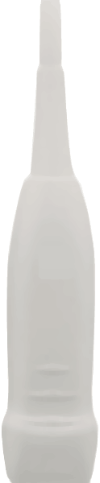
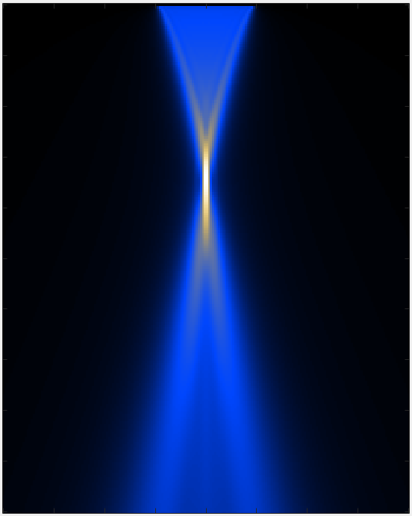
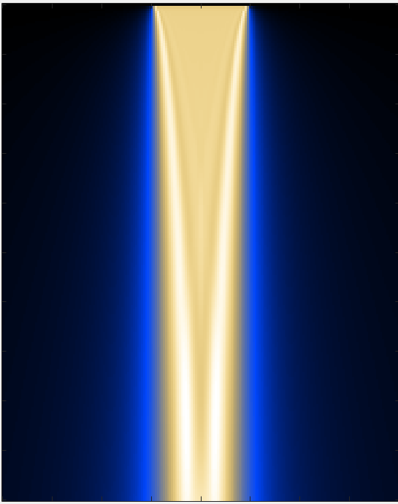
Ultrasound imaging
Maximum pressure at the depth of focalization
More uniform wave
Ultrasound transducer operating mode
Focused imaging
Plane wave imaging

Slide 6
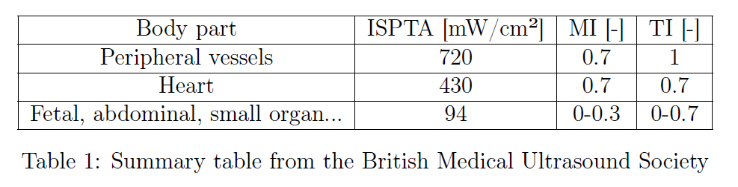
Safety standards
MI (Mechanical Index) ➔ Acoustic cavitation
TI (Thermal Index) ➔ Thermal effects
ISPTA (Intensity Spatial Peak Temporal Average) ➔ Power per meter emitted by the transducer

Slide 7
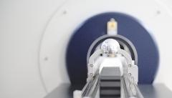
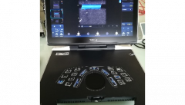
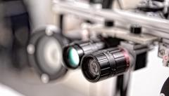

The
CREATIS (Centre de Recherche en Acquisition et Traitement de l'Image pour la Santé)
PILoT: PLATEFORME D'IMAGERIE MULTIMODALE SUR LYONTECH
Imaging platform
Applications on Magnetic Resonance Imaging (MRI), Optics and Ultrasound Imaging

Slide 8
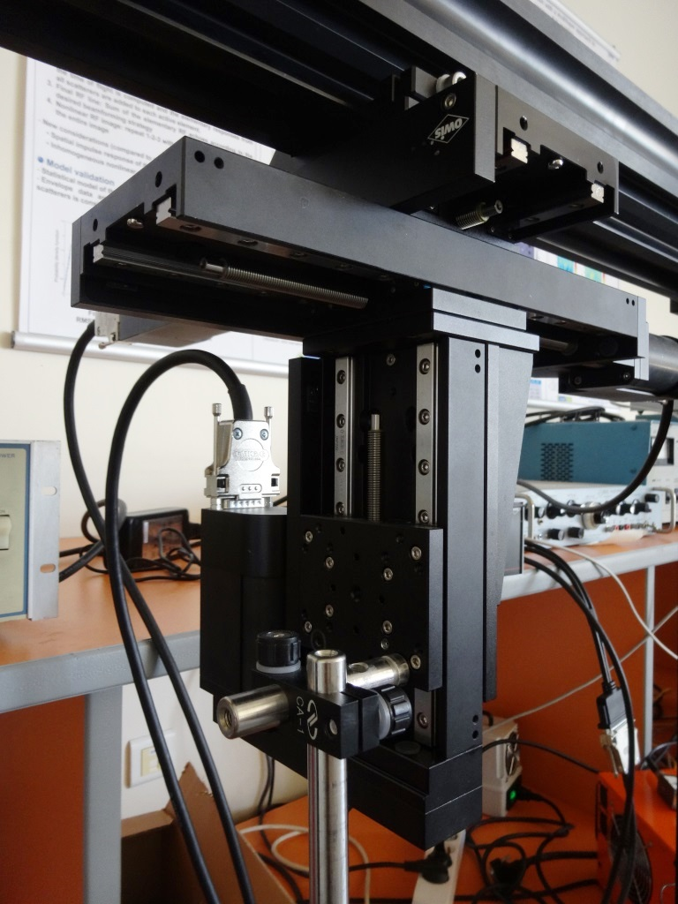
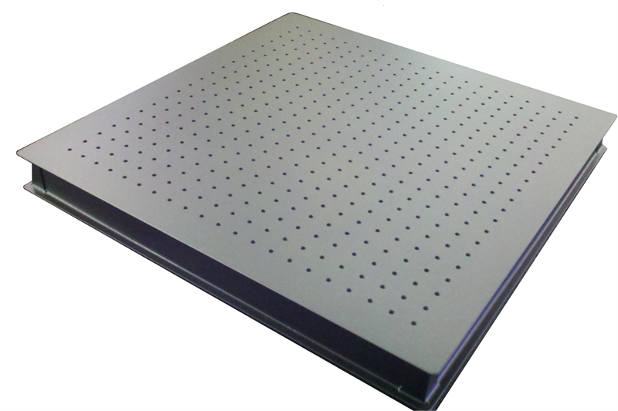
The PILoT platform
X
DC motor-driven translation (Owis, Germany) :
Length X and Z : 95 mm, Y : 195 mm
Accuracy : 1,25 µm
Y
Z
Three 750 mm profiles mounted in an inverted U-shape and mounting accessories
Controller 3 axis with software and DLL
An optical board of 1000 x 400 x 33 mm, weight : 32 kg
8

Slide 9
The PILoT platform

Slide 10
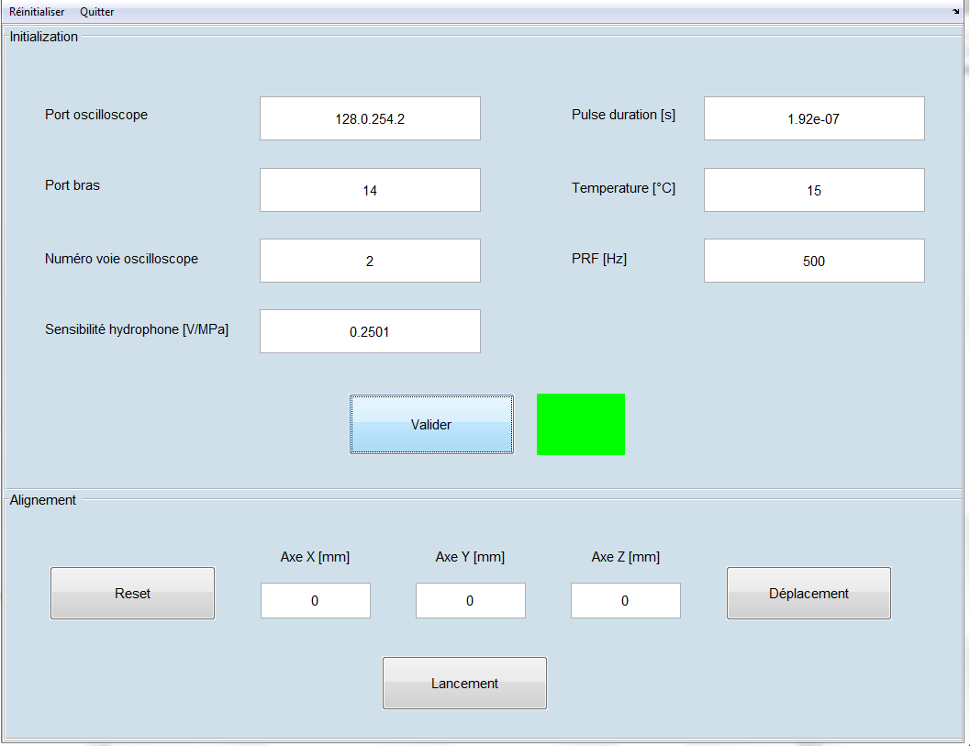
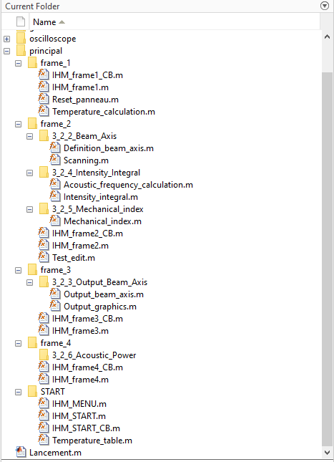
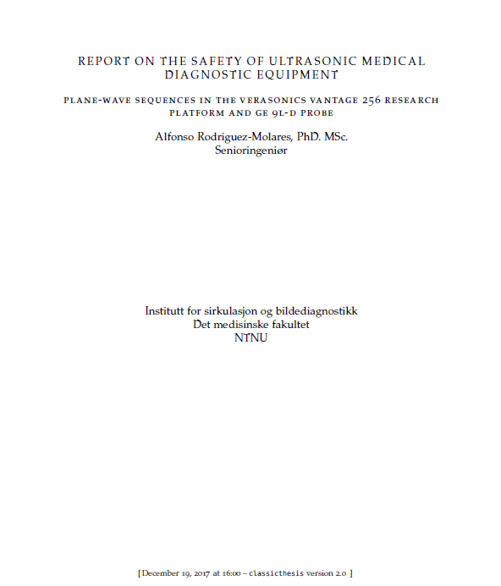
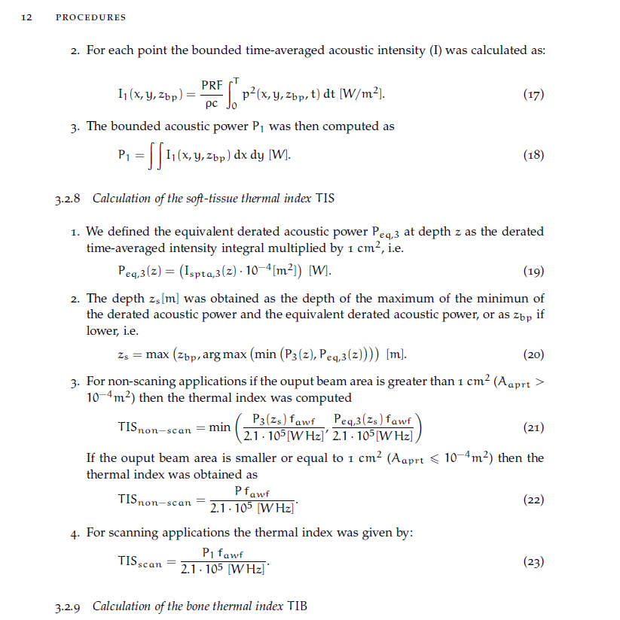

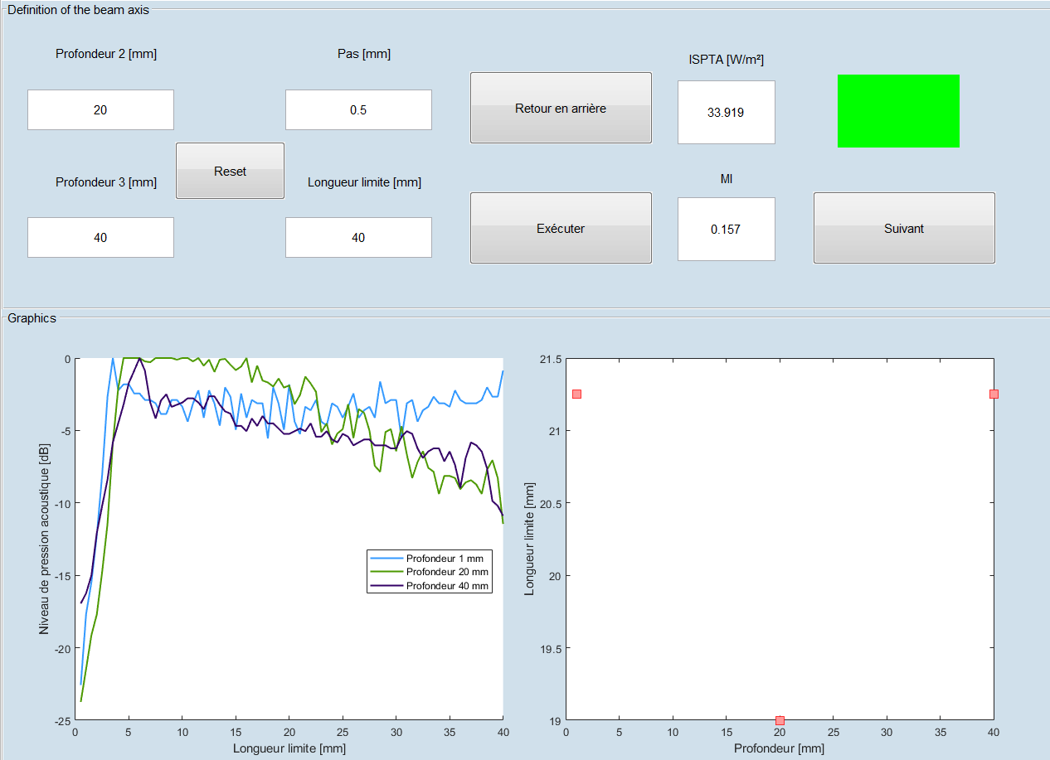
A new tool to design in MatLab
Rodriguez-Molares, A., REPORT ON THE SAFETY OF ULTRASONIC MEDICAL DIAGNOSTIC EQUIPMENT, 2017, Institutt for sirkulasjon og bildediagnostikk, P.9-13.

Slide 11
Start
Initialization: Pulse duration, Temperature, PRF, Sensibility, Oscilloscope channel’s number
Frame 1
Moving the hydrophone along X, Y an Z axis
Inputs: Depths, Step, Y-axis limit length
NO
THE USER CAN GO BACK
< seven consecutive samples inside the output beam area
Sound pressure level and beam axis calculation
Frame 2
Plotting the curves
YES
ISPTA and Mechanical Index calculation
Input: X-axis limit length value
THE USER CAN GO BACK
Frame 3
Output beam area and breakpoint depth calculation
Exporting the main structure
Plotting the curves

Slide 12
Operation steps
Rodriguez-Molares, A., REPORT ON THE SAFETY OF ULTRASONIC MEDICAL DIAGNOSTIC EQUIPMENT, 2017, Institutt for sirkulasjon og bildediagnostikk, P.9-13.
Step 1: beam axis
Acquire three 1D scans in the lateral dimension at three depths to find the axis of the ultrasound beam.
Step 2: ISPTA and depth Z3
Calculate ISPTA along the beam axis.
Find the depth Z3 corresponds to the maximum ISPTA.
Step 3: MI
Calculate MI at depth Z3.
Step 5: Measurement and calculation of the sound power level P3
Acquire a 2D scan at depth Zbp.
Integrate intensities to obtain power P.
Calculate power P3 as a function of the depth.
Step 4: Beam exit area
Acquire 1D scan in lateral and elevation.
Calculate an area and an associated depth Zbp.
Step 6 : TI calculation
Calculate TI as a function of P3.

Slide 13
Ultrasound beam axis
Step 1: beam axis
Acquire three 1D scans in the lateral dimension at three depths to find the axis of the ultrasound beam.
Step 2: ISPTA and depth Z3
Calculate ISPTA along the beam axis.
Find the depth Z3 corresponds to the maximum ISPTA.
Step 3: MI
Calculate MI at depth Z3.
Step 5: Measurement and calculation of the sound power level P3
Acquire a 2D scan at depth Zbp.
Integrate intensities to obtain power P.
Calculate power P3 as a function of the depth.
Step 4: Beam exit area
Acquire 1D scan in lateral and elevation.
Calculate an area and an associated depth Zbp.
Step 6 : TI calculation
Calculate TI as a function of P3.

Slide 14

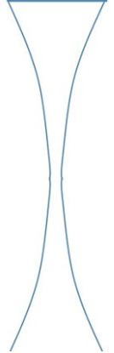
Ultrasound beam axis
Depth 1
(1 mm)
Depth 1
(1 mm)
Depth 2
Depth 2
Beam axis equation
Beam axis equation
Depth 3
Depth 3
Plane wave emission
Focused wave emission

Slide 15
ISPTA
Step 1: beam axis
Acquire three 1D scans in the lateral dimension at three depths to find the axis of the ultrasound beam.
Step 2: ISPTA and depth Z3
Calculate ISPTA along the beam axis.
Find the depth Z3 corresponds to the maximum ISPTA.
Step 3: MI
Calculate MI at depth Z3.
Step 5: Measurement and calculation of the sound power level P3
Acquire a 2D scan at depth Zbp.
Integrate intensities to obtain power P.
Calculate power P3 as a function of the depth.
Step 4: Beam exit area
Acquire 1D scan in lateral and elevation.
Calculate an area and an associated depth Zbp.
Step 6 : TI calculation
Calculate TI as a function of P3.

Slide 16
Mechanical index
Step 1: beam axis
Acquire three 1D scans in the lateral dimension at three depths to find the axis of the ultrasound beam.
Step 2: ISPTA and depth Z3
Calculate ISPTA along the beam axis.
Find the depth Z3 corresponds to the maximum ISPTA.
Step 3: MI
Calculate MI at depth Z3.
Step 5: Measurement and calculation of the sound power level P3
Acquire a 2D scan at depth Zbp.
Integrate intensities to obtain power P.
Calculate power P3 as a function of the depth.
Step 4: Beam exit area
Acquire 1D scan in lateral and elevation.
Calculate an area and an associated depth Zbp.
Step 6 : TI calculation
Calculate TI as a function of P3.

Slide 17
Output beam area
Step 1: beam axis
Acquire three 1D scans in the lateral dimension at three depths to find the axis of the ultrasound beam.
Step 2: ISPTA and depth Z3
Calculate ISPTA along the beam axis.
Find the depth Z3 corresponds to the maximum ISPTA.
Step 3: MI
Calculate MI at depth Z3.
Step 5: Measurement and calculation of the sound power level P3
Acquire a 2D scan at depth Zbp.
Integrate intensities to obtain power P.
Calculate power P3 as a function of the depth.
Step 4: Beam exit area
Acquire 1D scan in lateral and elevation.
Calculate an area and an associated depth Zbp.
Step 6 : TI calculation
Calculate TI as a function of P3.

Slide 18
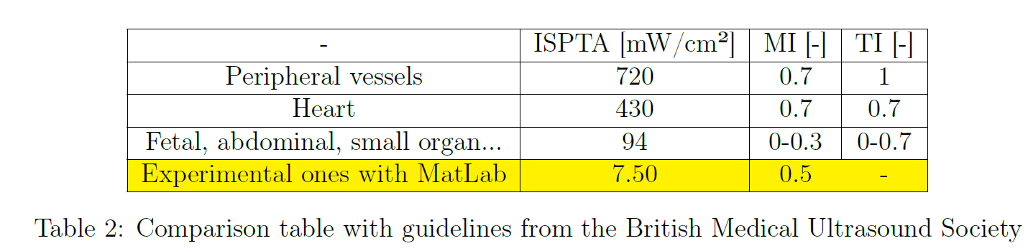
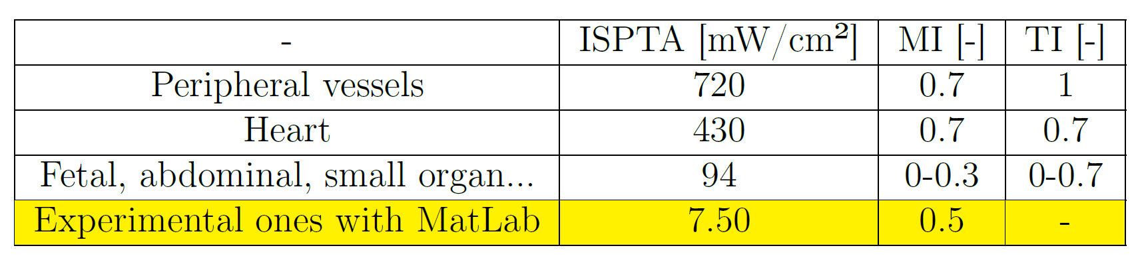

Results & analysis
Plane wave case
Good compared with the standards

Slide 19

Results & analysis
LabView comparison with the same inputs
Dimension | Length (mm) | Step (mm)
Axial (Z) | 45 | 0.5
Lateral (X) | 46 | 0.5
Elevation (Y) | 1 | 1
- | LabView | Matlab
ISPTA (mW/cm²) | 44 | 7.5
MI | 0.75 | 0.76*
Zbp (m) | 0.040 | 0.031
ISPTA is not good
* Calculated again from the data

Slide 20
Conclusion
Need to be corrected and checked again with LabView’s results
Step 1: beam axis
Acquire three 1D scans in the lateral dimension at three depths to find the axis of the ultrasound beam.
Step 2: ISPTA and depth Z3
Calculate ISPTA along the beam axis.
Find the depth Z3 corresponds to the maximum ISPTA.
Step 3: MI
Calculate MI at depth Z3.
Step 5: Measurement and calculation of the sound power level P3
Acquire a 2D scan at depth Zbp.
Integrate intensities to obtain power P.
Calculate power P3 as a function of the depth.
Step 4: Beam exit area
Acquire 1D scan in lateral and elevation.
Calculate an area and an associated depth Zbp.
Step 6 : TI calculation
Calculate TI as a function of P3.
Notes:
The main skeleton of the code is written and functionalities can be used again for steps 5 and 6.

Slide 21
Conclusion
A brand new MatLab tool is almost done following all steps described in the safety of ultrasonic equipment report.
Not finished: Steps 5 and 6 remain to be completed in order to get the Thermal Index
The first results seemed good at first for the acoustic safety indices ISPTA and MI taking into account the literature and health guidelines
Nevertheless, few mistakes inside the code about the calculation of the PPI and ISPTA values after doing comparisons with LabView
Checking and assessing the uncertainties remains another priority for the future of this project

Slide 22
Thank you for your attention
Any questions ?

Slide 23
Uncertainties
Hydrophone measures uncertainty : ± 1 dB
Oscilloscope measures uncertainty
BNC cable error : neglected
Position error of the 3D-axis system : < 25μm / 100 mm
Quality of the water (not filtered and degassed) : risk of cavitation for pressure > 1 MPa
Integral calculation in MATLAB using the Trapezium method
Commercial systems must show the same sources of error
Added directly during the conversion between voltage and pressure to have the worst case
The measurement should be repeated several times in order to know the overall error percentage

Slide 24
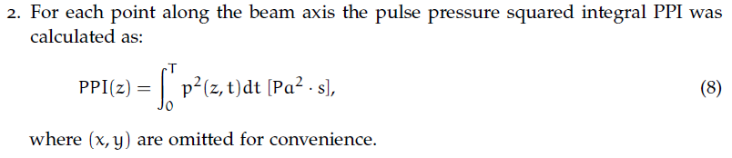
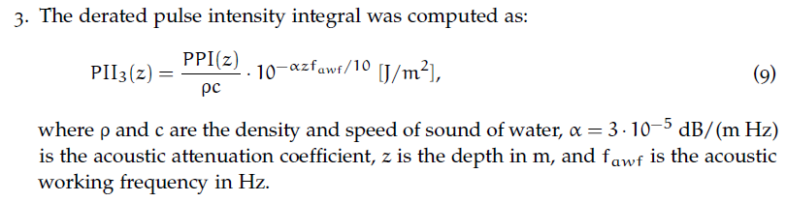
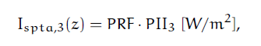
ISPTA

Slide 25
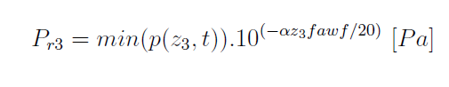
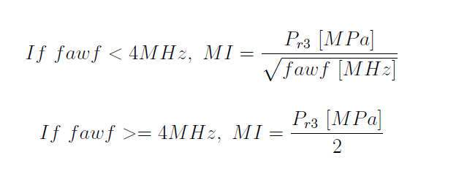
Mechanical index
With f_{awf} : acoustic-working frequency
Z₃ : depth found for the maximum ISPTA
α = 3.10-5 dB/(m Hz) : acoustic attenuation coefficient

Slide 26
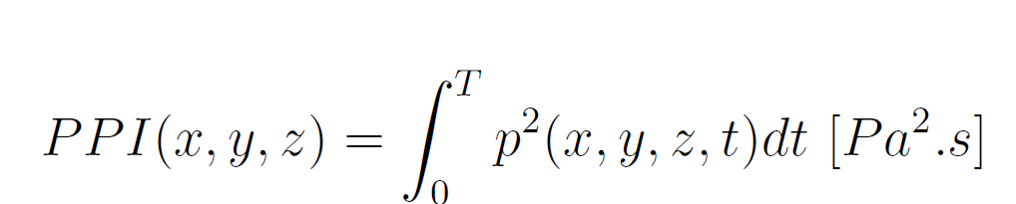
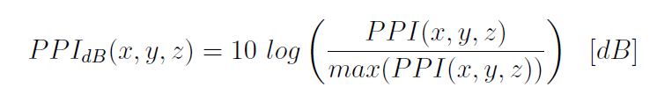
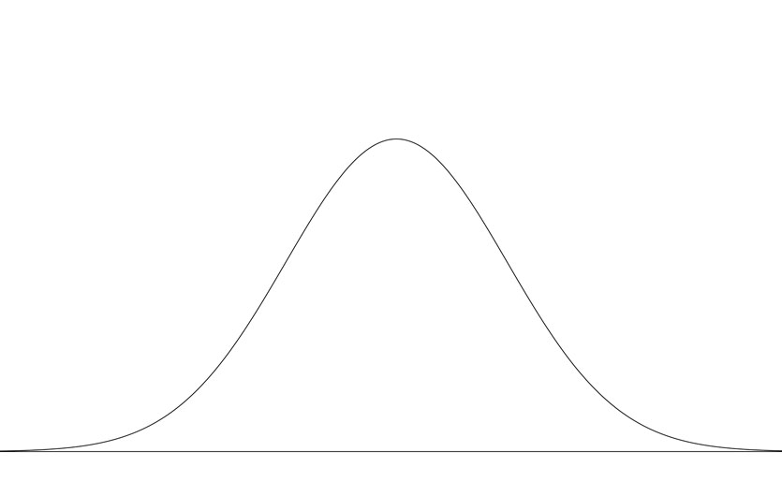
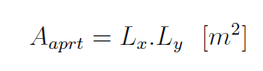
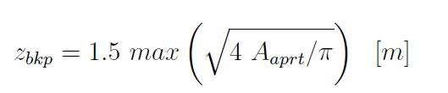
Output beam area
Scanning along X and Y-axis ➔
PPI [dB]
-12 dB
Beam Lx or Ly [mm]
Depth [mm]

Slide 27
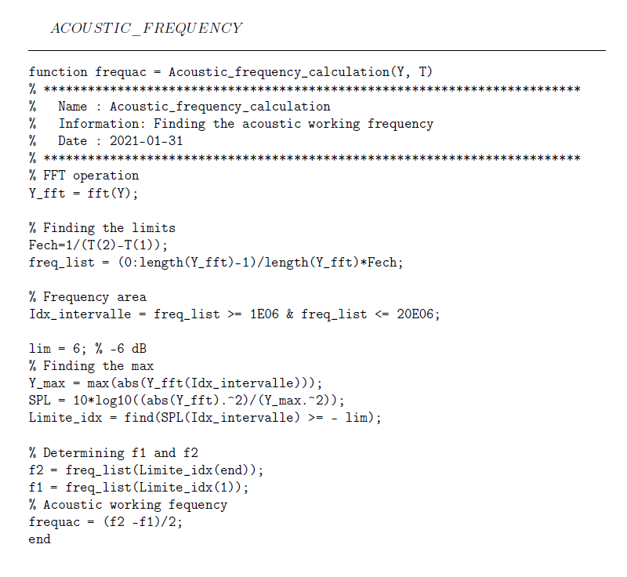
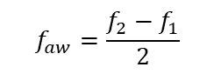
Acoustic working frequency
Y(dB)
-6 dB
frequency (Hz)
f1
f2
$$f_{aw}=\frac{f_{2}−f_{1}}{2}$$

Slide 28
Comparison with commercial solutions
 | The setup | Synthesis of commercial solutions
Architecture | Composed of several parts | One block
Price without options (k€) | 10 (in 2013) | 50 (in average, quotation in 2018-2020)
Automatic calculation of safety indexes | ISPTA, MI and TI | ISPTA, pulse duration, MI + others
Regulatory requirements | IEC60601-2-37 [5], IEC61102 [6] | IEC60601-2-37 + others
Minimum step size in µm | 1.25 | Between 0.198 and 5.5
Dimension of the travel: X x Y x Z in cm | 9.5 x 19.5 x 9.5 | 34 x 28 x 32
Programming language | Labview and Matlab | Customization possibilities
Options | Possible to add | Temperature Probe, rotational axes, water conditionning system
[5] ‘IEC 60601-2-37:2004 Medical electrical equipment – Part 2-37: Particular requirements for the safety of ultrasonic medical diagnostic and monitoring equipment’. International Electrotechnical Commission Edition 1:2001,
[6] I. E. Commission, ‘Measurement and characterization of ultrasonic fields using hydrophones in the frequency range 0.5 MHz to 15 MHz’. IEC, 1991

Slide 29
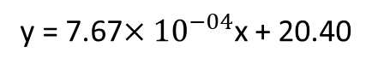
Results & analysis
Plane wave case
Depth 1
(1 mm)
Depth 2
Beam axis equation
Depth 3
y = 7.67${×10}^{−04}$x + 20.40

Slide 30
Results & analysis
Focused wave case
Depth 1
(1 mm)
Depth 2
Beam axis equation
Depth 3

Slide 31
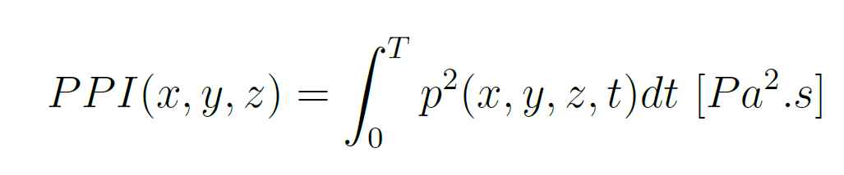
Results & analysis
Comparison with LabView
Labview
MatLab

Slide 32
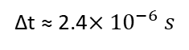
Results & analysis
Comparison with LabView
LabView: blue signal
MatLab: red signal
∆t ≈ 2.4${×10}^{−6}s$

Slide 33
Results & analysis
Comparison with LabView
 | PPI from the MatLab signals and calculated with MatLab (after correction) | PPI from LabView signals and calculated with LabView
PPI (Pa².s) | 2,6152 e+05 | 6.1289 e+05
 | ISPTA from the MatLab signals and calculated with MatLab (after correction) | IPSTA from LabView signals and calculated with LabView
ISPTA (mW/cm²) | 10,5 | 45
Not ok again: more investigations are required

